Slide 1

State and County Health and Diversity Measures: Are We/You Moving the Needle?
March 20, 2018

Slide 2
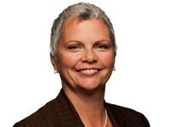
Today’s Webinar
Discuss Campaign Dashboard measures around diversity in nursing and how they fit within RWJF’s Culture of Health framework.
Review the interactive County Health Rankings website to learn more about your state’s health and who you are serving.
Discuss how this information and data can be used to engage new and existing stakeholders, and how Culture of Health concepts can be used in sustainability efforts.
Winifred V. Quinn, PhD
Director, Advocacy & Consumer Affairs
Center to Champion Nursing in America
Notes:
Director Lead– Welcome & Intro – 5 Minutes
Good afternoon and welcome. Thank you all for taking time to join us for today’s webinar, State and County Health and Diversity Measures: Are we/you moving the needle?
Discuss Campaign dashboard measures around diversity in nursing and how they fit within RWJF’s Culture of Health framework.
Review the interactive County Health Rankings website to learn more about your state’s health and who your are serving.
Discuss how this information and data can be used to engage new and existing stakeholders, and how Culture of Health concepts can be used in sustainability efforts.
Before we go too much further, I want to mention that we are recording today’s webinar, so if you miss a section or would like to pass it on to a colleague, you can find the recording by going to www.campaignforaction.org/webinars
Also will be taking questions over the phone at the end of the webinar but you can type questions throughout the webinar using the chat function. Be sure to send your question to “everyone”.

Slide 3
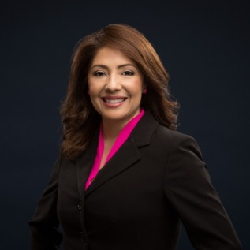
Today’s Facilitator
Adriana Perez, PhD, ANP-BC, FAAN
Assistant Professor, University of Pennsylvania School of Nursing
Diversity Consultant, Center to Champion Nursing in America

Slide 4
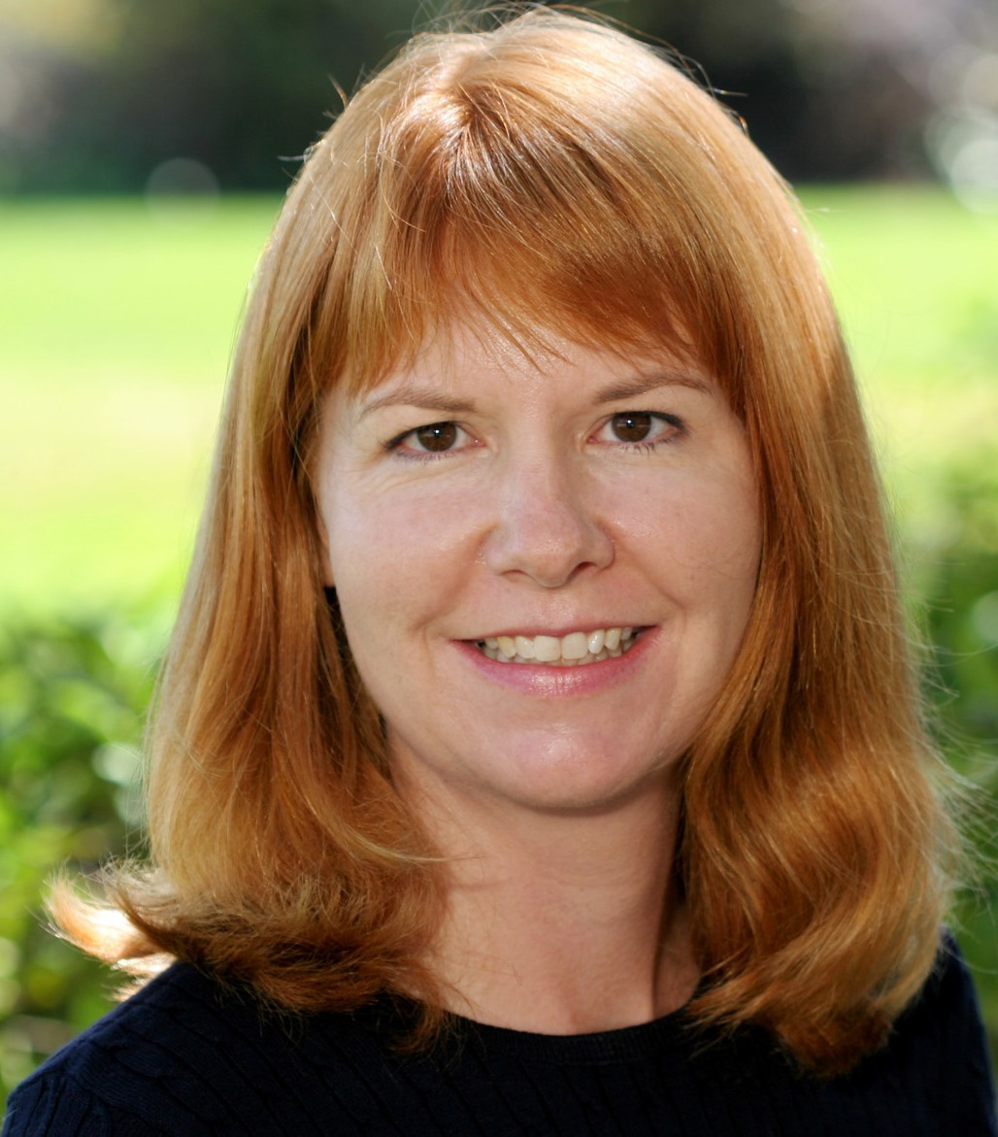
Today’s Speakers
Joanne Spetz, PhD
Professor, Philip R. Lee Institute for Health Policy Studies
Associate Director for Research, Healthforce Center
University of California, San Francisco
Notes:
Adriana:
I would like to introduce the speaker for today’s webinar. Joanne Spetz, PhD is a professor at the Philip R. Lee Institute for Health Policy Studies and Associate Director for Research, Health force Center at the University of California, San Francisco

Slide 5
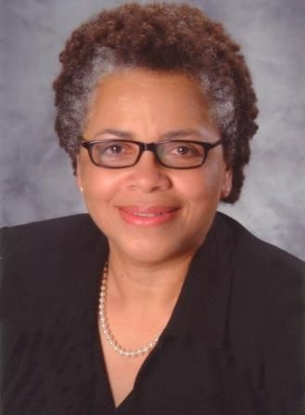
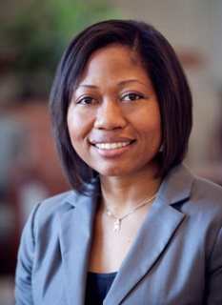
Today’s Webinar
Introduce the Campaign for Action Dashboard.
Discuss how diversity fits within the Action Areas of the
Culture of Health framework.
Examine two measures of the Campaign Diversity Dashboard.
Discuss sources of national and state-level data about diversity.
Deborah Washington,
PhD, RN, MS
Director, Diversity Patient Care Services,
Massachusetts General Hospital
Carmen Alvarez,
PhD, RN, CRNP, CNM
Assistant Professor
Department of Community-Public Health
Johns Hopkins School of Nursing
Notes:
Director Lead– Welcome & Intro – 5 Minutes
Deb: Good afternoon and welcome. Thank you all for taking time to join us for today’s webinar. As the co-leads of the Campaign for Action Diversity Steering committee, we’re particularly excited to introduce you to the Campaign’s new diversity dashboard indicator.
A diverse nursing workforce is one that can better support the well-being of the whole community. The Future of Nursing: Campaign for Action's diversity dashboard indicator shows the progress that Action Coalitions are making as they create a nursing workforce that is as diverse as the nation. This is the first of two webinars, where we will provide an overview of the Campaign dashboard, and examine the following measures:
• Percentage of pre-licensure nursing program graduates by race/ethnicity and gender compared with the U.S. population.
• Number of Action Coalitions that have a representative of an ethnic or racial minority nursing organization, or men in nursing chapter, as a co-lead or voting member of their senior-level policymaking body.
Joanne Spetz, PhD, data adviser to the Center to Champion Nursing in America, will also discuss sources of national and state-level data about diversity and explain how the diversity dashboard measures were developed.
The Campaign has developed additional secondary indicators, which will be presented in a webinar to be held at a later date.
Carmen: Before we go too much further, I want to mention that we are recording today’s webinar, so if you miss a section or would like to pass it on to a colleague, you can find the recording by going to www.campaignforaction.org/webinars
Also will be taking questions over the phone at the end of the webinar but you can type questions throughout the webinar using the chat function. Be sure to send your question to “everyone”.

Slide 6
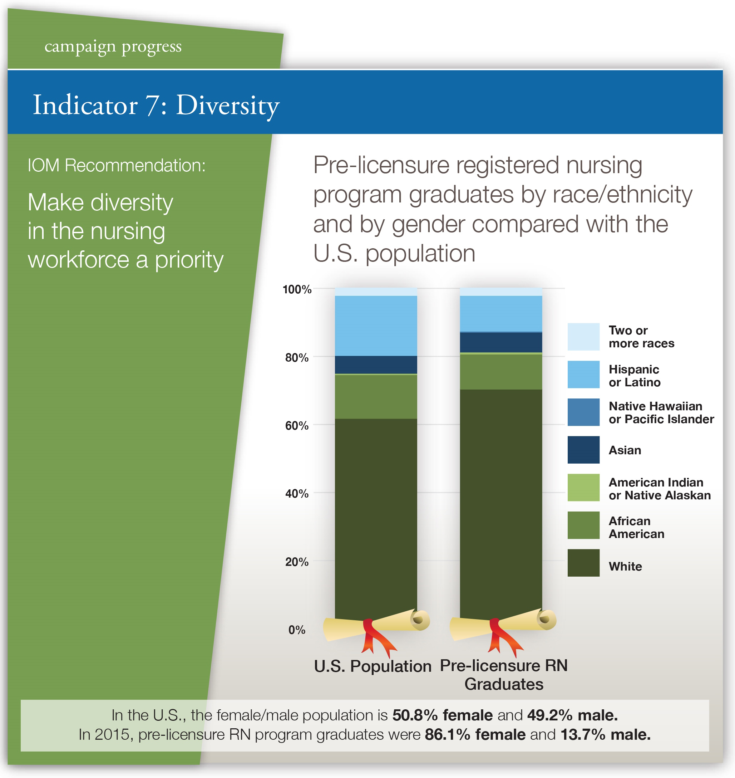
Notes:
Carmen: The primary diversity dashboard indicator is pre-licensure nursing program graduates by race/ethnicity and gender compared to the US population. In the bar graphs above, you can see the current ethnic/racial distribution as compared to 2015 pre-licensure RN graduates.
The goal is to prepare a nursing workforce which will, ultimately, better reflect the diversity of the population they serve. The decision was made specifically to focus on pre-licensure graduates because, as the entry point for the profession, the demographics of this population reflect what the demographics of the whole profession will look like years down the road.
We are also looking at ways to bring the gender balance of the nursing profession in line with the distribution of the gender population. As of 2015, the baccalaureate and graduate nursing student populating is still overwhelmingly female, at 88%.

Slide 7
Dashboard Diversity Indicators
Top-level Indicator: Diversity of new RN graduates
  More rapidly affected by current actions
  Cannot change race/ethnicity/gender of incumbent population
Secondary indicators
  Diversity of total RN population
  Diversity of new graduates by degree type
  Diversity of nursing doctoral graduates
Notes:
In the end, we selected the diversity of pre-licensure graduates as our top-level Dashboard indicator. This is because it’s the most actionable measure. We can’t do much to change the race, ethnicity, or gender of our incumbent workforce. Certainly, we should strive to retain our diverse nurses, but overall retention in the nursing workforce is very high and thus there is little room for improvement.
Programs developed by Campaign participants are really aimed at changing the diversity of new entrants to the profession, and thus this is where we want there to be the most focus.
That said, we are also collecting data on some secondary indicators – the diversity of the total RN population, the diversity of new graduates by type of degree, and the diversity of doctoral graduates.

Slide 8
Data Sources: Pre-Licensure RN Grads
Integrated Post-Secondary Education Data System (IPEDS)
  Administered by US Department of Education
  Used for AD and diploma graduates
American Association of Colleges of Nursing
  Used for BS/BSN graduates
Comparison: US population data from US Census Bureau
Notes:
To measure the diversity of pre-licensure RN graduates, we relied on 2 data sources, the Integrated Post-Secondary Education Data System from the US Dept of Education, and the American Association of Colleges of Nursing annual survey.
To compare RN graduate diversity to the US population, we used data from the US Census Bureau, which are easy to find online both for the US and for each state.

Slide 9
Diversity of Pre-Licensure RN Graduates
Note: Unknown and non-US are not in Census population data
Notes:
Here is the top-level Diversity indicator over time, from 2011 to 2015. As you can see, pre-licensure graduate diversity has improved somewhat over time, with greater shares of Hispanic/Latino graduates in particular. The shares that are African-American and Asian have been fairly stable over this period.

Slide 10
RN Graduates vs. US Population: Diversity
Notes:
We can compare these data to the total US population. As you can see, the greatest degree of under-representation among our pre-licensure RN graduates is for Hispanic and Latinos – but there also is under-representation for African-Americans. It’s also worth noting that we do not have data on the diversity of new graduates by Asian sub-groups. Some state-level surveys include such data, including California, and these figures suggest that some Asian groups such as Filipinos are over-represented while others, such as Southeast Asians, are under-represented.

Slide 11
Gender of Pre-Licensure RN Graduates
Notes:
What about the gender diversity of pre-licensure graduates? This has improved slightly over time, going from 12.7% male in 2011 to 13.7% in 2015.

Slide 12
RN Graduates vs. US Population: Gender
Notes:
Of course, compared with the total US population, men are woefully under-represented in nursing.

Slide 13
Data Source: Total RN Population
American Community Survey
  Administered by US Census Bureau
  Conducted monthly and data released annually
RNs identified by self-reported occupation
  Currently working
  Unemployed but reports normal occupation is nursing
Notes:
The main source of data on the RN workforce is the American Community Survey. We use these data for multiple Dashboard indicators, and we’ve presented detailed information about these data in previous webinars.
RNs are identified by their self-reported occupation in these data.

Slide 14
Total RN Population Over Time
Notes:
Here is the overall diversity of the RN workforce from 2009 through 2015. As you can see, the diversity has been slowly improving, due to the increasing diversity of new graduates.

Slide 15
Total RN vs. US Population Over Time
Notes:
When compared with the US population, however, it’s easy to see that all non-white groups are under-represented in nursing.

Slide 16
RN Graduates: Race/Ethnic Diversity, by Degree Type
Notes:
Are there differences in the diversity of pre-licensure graduates by degree type? This is a secondary indicator we are tracking. Here, you can see the data from 2009 and 2015.
In both years, there is a similar share of white nurses among associate and bachelor’s graduates, but a lower share among entry-level master’s program graduates. Note that the total US population is 61.6% White, so in master’s programs, Whites are slightly under-represented.
There are more African-American graduates in AD programs than BSN and master’s programs.
Asians are a greater share of master’s graduates, accounting for 13.1% in 2015, and also are more often found among bachelor’s graduates than associate degree graduates.
Hispanic and Latino nurses are more often graduating from associate degree programs.

Slide 17
RN Graduates: Gender Diversity, by Degree Type
Notes:
There is very little difference in the gender mix of pre-licensure graduates by degree type. Men are slightly better represented in associate degree programs, but the difference is not large.

Slide 18
RN Doctoral Graduates:
Race/Ethnic Diversity
Notes:
What about doctoral graduates?
Doctoral graduates have become somewhat more diverse, and diversity is greater for PhD graduates than for DNP graduates. In 2015, Blacks were well-represented in both PhD and DNP programs, with slightly over 12% of graduates – they comprise 12.4% of the total US population.
Asians are slightly over-represented in PhD programs and under-represented in DNP programs – they are 5.4% of the total US population.
Hispanic and Latino nurses are greatly under-represented in doctoral education.
It’s worth noting that about 7% of graduates from our PhD programs are international students. Our doctoral programs are preparing not only our own faculty and nurse leaders, but those for around the world.

Slide 19
RN Doctoral Graduates:
Gender Diversity
Notes:
Gender diversity in doctoral programs is lower than among pre-licensure graduates overall. Only about 8% of PhD and 11% of DNP graduates are men.

Slide 20
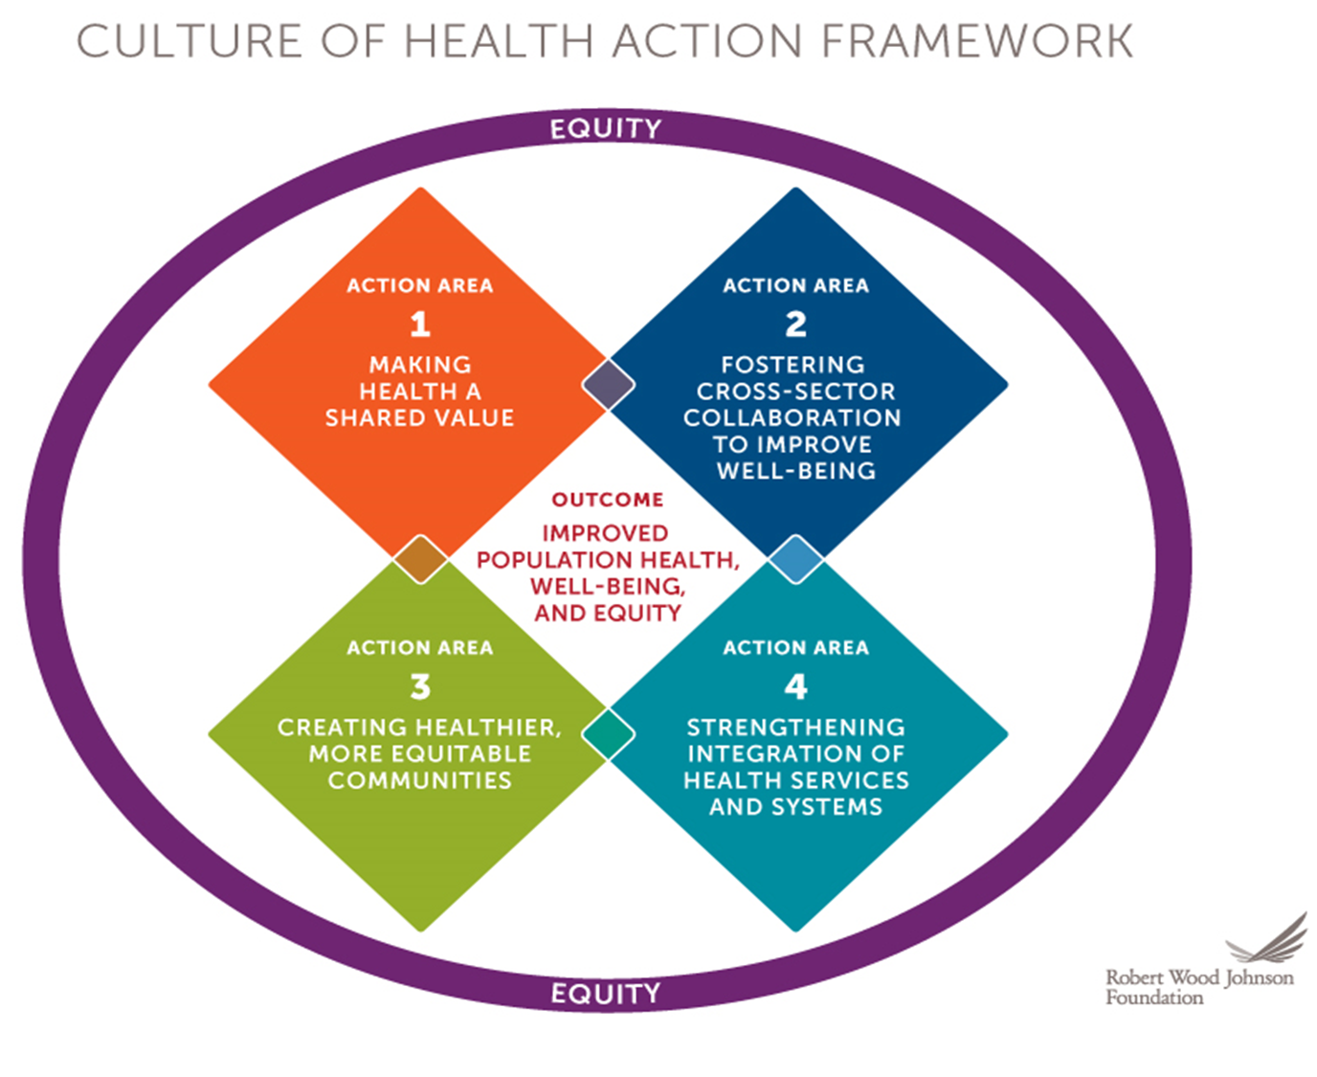
Action Framework
www.cultureofhealth.org
Notes:
Next we would like to discuss how we can take steps towards using both the culture of health framework and county health rankings model to enhance our current efforts around health promotion for our communities.
As we increase our demographic diversity within our workforce, how else can we diversify to support a culture of health. As the county health rankings model illustrates, clinical care and health services explain just a portion of health and well-being
This Action Framework can help all of you get started. RWJF developed the Framework with the help of the RAND Corporation. We want to catalyze a national movement toward improved health, well-being, and equity. The Framework is meant to broaden the discussion of what influences health and chart progress.
The Action Framework addresses the interdependence of social, economic, physical, and environmental factors. It is intended to generate unprecedented collaboration and chart our nation’s progress toward building a Culture of Health. We want to improve health, well-being and equity for all.
When we make health a shared value; foster cross-sector collaboration; create healthier, more equitable communities; and strengthen integration of health services and systems, we are more likely to see improved health, well-being, and equity.
I’m going to share some examples of how Action Coalitions can use this framework to build a Culture of Health.

Slide 21
AARP Community Engagement
AARP Massachusetts volunteer
Mayor’s Advisory Council on Aging Member, City of Boston
Advisory committee member for the Massachusetts Healthy Aging 2018 Data Report
National Center for Creative Aging member
Community activist
Artist
Student of gerontology

Slide 22
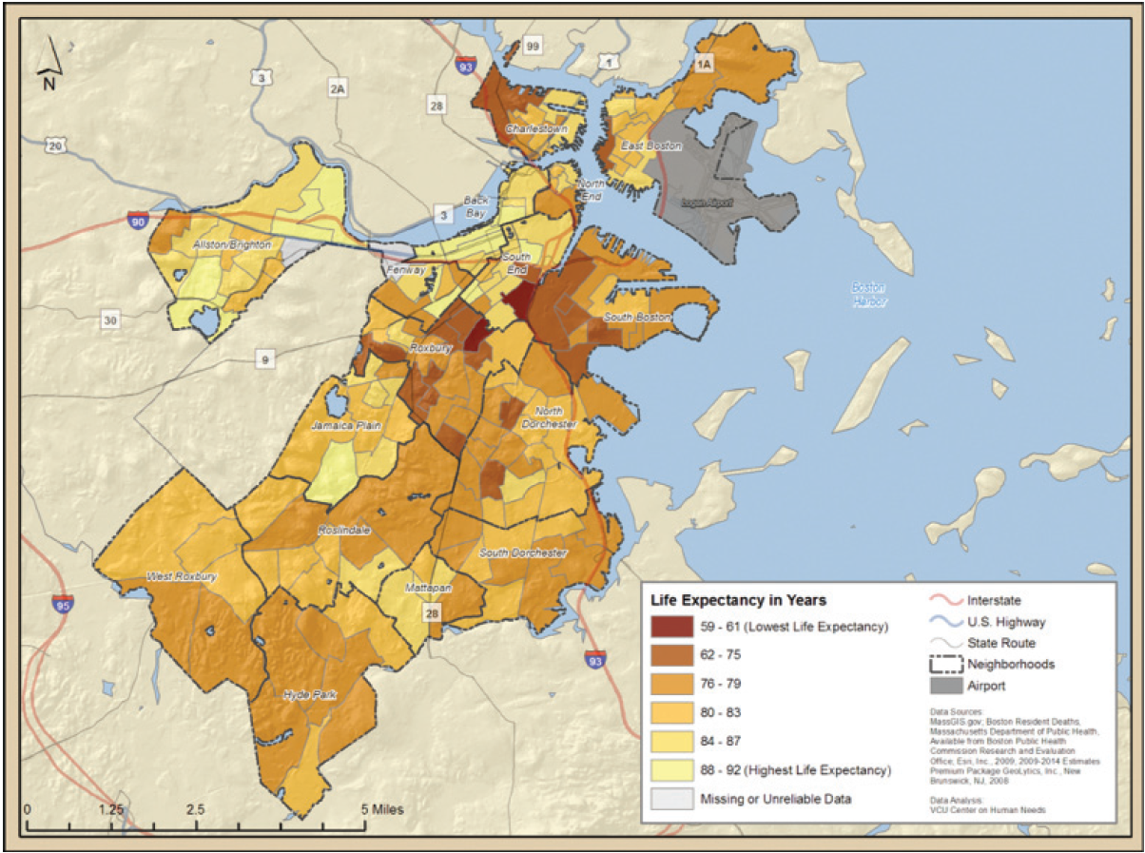
Boston Report
Notes:
map from the Social Capital and Health Outcomes in Boston report, … life expectancy in the city ranges … low of 59 years, to a high of 92 years … average life expectancy at 77.9 years
Life expectancy … two darkest shades on the map falls below the average (59 – 76). …Makes you wonder how bad is it in these relatively small geographic areas? What conditions can be so strong that they cut life expectancy short by almost 20 year compared to the average? … like losing an entire generation! Grandparents do not get to see their grandkids grow-up and children who grow up without elders in their life to help them develop.
A recent Globe series, Color Line Persists, In Sickness as in Health, examining issues of racism in Boston noted ‘certain patterns of segregation remain stubbornly entrenched, threatening to undermine the region’s mission of equitable care for everyone.” [next slide]

Slide 23
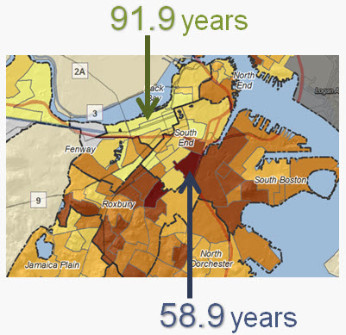
Boston
Notes:
… distortion deliberate to view smaller area(s).
… life expectancy varies by almost 33-years, between census tracks ...
… affluent Charles River Basin, … longest … at 91.9 years (between Massachusetts Avenue and Arlington Street, north of Commonwealth Avenue).
… two economically depressed area(s) in Roxbury … shortest life expectancy at 58.9 years, (between Massachusetts Avenue and Dudley Street and Shawmut Avenue and Albany Street). … these two areas falls below countries such as Cambodia, Gambia, and Iraq.
So why is this? [next slide]

Slide 24
Indicators to Address Now
Top 3 indicators:
  Diabetes
  Hypertension
  Obesity
Followed by:
  Prostate cancer
  Congestive heart failure
  % with 15 or more poor mental health days within past month
Notes:
… background sense of the data, the Community Profile Reports, ….compare outcomes in Roxbury to City and State averages, … over 100 indicators of individual and community health … Wellness & Prevention, Nutrition, Chronic Diseases, Mental Health and Disabilities for 351 cities and towns and 16 neighborhoods in Boston.
… asked to review and compare …outcomes and establish top 3 priorities, stakeholders identified diabetes, hypertension and obesity … address sooner rather than later … addressing obesity and its root causes would greatly benefit outcomes for other health conditions.
top 3 followed by prostate cancer, congestive heart failure and poor mental health days
[If asked]
Other areas of concern include:
Lower levels of physical activity, poor overall health and lower rates of preventative vaccines
Kidney disease.
Inadequate consumption of fruits and vegetables, tooth loss, smoking, poor mental health days and lack of emotional support
Primary data sources used: Census data, Behavioral Risk Factor Surveillance Survey (BRFSS) data, and Centers for Medicare and Medicaid Services (CMS) data.

Slide 25
Comparison of Select Indicators
% of Population 65*
Notes:
Knowing where you stand is important. The Globe article that I referenced earlier noted that black people suffer far worse health overall than whites because of poverty and environmental reasons. The article went on to say that city planners confirmed that this suffering is a consistent and growing condition in Boston…outcomes for the top areas of concern, compared to the city or state averages. Roxbury fairs worse (with the exception of congestive heart failure).
… the CDC, 7 of the top 10 causes of death in 2014 were chronic diseases … 86% of the nation’s $2.7 trillion annual health care expenditures … for people with chronic and mental health conditions.

Slide 26
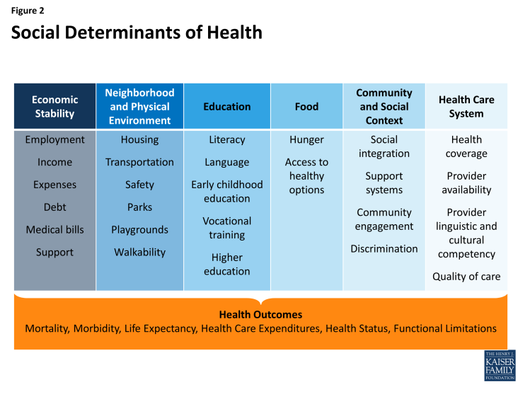
Social Determinants of Health
Notes:
Breaking it down further …
We will take a closer look at some of the challenges that affect each of the key areas in the communities of Dorchester (south), Mattapan and Roxbury. [next slide]

Slide 27
Select Social Determinants of Health
DETERMINANTS TO HEALTH | Dorchester | Mattapan | Roxbury | State
Less than high school education | 37.6% | 37.0% | 41.7% | 20.4%
College degree | 11.9% | 9.8% | 12.1% | 25.1%
Speak only English at home | 74.3% | 78.6% | 76.0% | 83.4%
Violent crime rate / 100,000 persons | 845 | 845 | 845 | 428
Income below the poverty level past year | 18.5% | 18.4% | 25.9% | 9.3%
Households with annual income < $20,000 | 38.9% | 39.4% | 53.2% | 28.4%
Notes:
In looking at some of the determinants of health in the Mattapan, Roxbury, South Dorchester neighborhoods of Boston, education rates are lower, crime rates higher, and poverty rates are almost two times the state average. In these communities, greater numbers of people speak a language other than English in their home, “…so many factors—rundown housing, exposure to environmental toxins, and poverty—contribute to high rates of disease and death for the city’s blacks…” noted the Globe article.
In 2017 AARP did a Healthy Aging event at the Reggie Lewis Center in Roxbury. The event featured local and national experts addressing healthy aging in the areas of nutrition, exercise, yoga, tai-chi, mindfulness meditation, relationships and technology. Attendance exceeded expectations and participants were overwhelmingly positive and receptive to new possibilities. Not only did we see firsthand, but we heard directly from people about developing a culture of healthy aging. This provided greater insight as the organization continues to work on behalf of the interest and needs of older adults.

Slide 28
Using County Health Rankings
Counties of minority communities
Data that informs the Culture of Health story
Data that informs the policy story as it relates to the built environment
Notes:
Using County Health Rankings to tell the Social Determinants of Health Story.
In population demographics you’ll find age, ethnicity, English proficiency. You’ll find data to help you tell the story within the frames of level of education in the county, income inequality, unemployment and violent crime rates. You’ll also find information that will help you to analyze the implications of the built environment and what that means for members of the community when it comes to issues like air pollution, housing problems or commuting as a context for health.

Slide 29
Action Framework
www.cultureofhealth.org
Notes:
All of that brings us to this important framework for nursing and its role in improving the health of populations. We need to demonstrate our connection with communities in terms of building relationships with its members. We need to show we understand the issues and which issues are a priority according to community members. And through all of this we need to establish the reputation of nursing as a discipline capable of delivering expertise that does make a difference when we lead and are involved.

Slide 30
Change
How to Change Direction?
Notes:
This is the ultimate question for us as we seek to establish, define and communicate what it means to be engaged in a Culture of Health.

Slide 31
Keeping the Momentum….
Since the launch of the Campaign for Action
  Positive trends for increasing diversity among pre-licensure RNs & nurses prepared at the doctorate level
We have to keep driving for more change
  American Indian or Alaska Native, and Native Hawaiian or other Pacific Islanders
  Diversity of the profession still does not represent the diversity of the nation
Achieving a Culture of Health for all, is going to depend on a diverse profession
Notes:
Overall, since the launch of the campaign for action, we have seen positive trends of increasing diversity among pre-licensure RNs and also among doctorally prepared nurses. And this should be encouragement to continue the work that we are doing and maybe also think about what we may need to do differently.
Despite the positive trend, we still have some groups that are yet to have increasing representation of their race/ethnic group within the nursing profession; also even though we have seen progress the diversity of our profession still does not represent that of the US population.
We know that diversifying our workforce is essential achieving a culture of health, the innovation that we need for a culture of health and health equity will only come from spaces where there is diversity of thought and people.

Slide 32
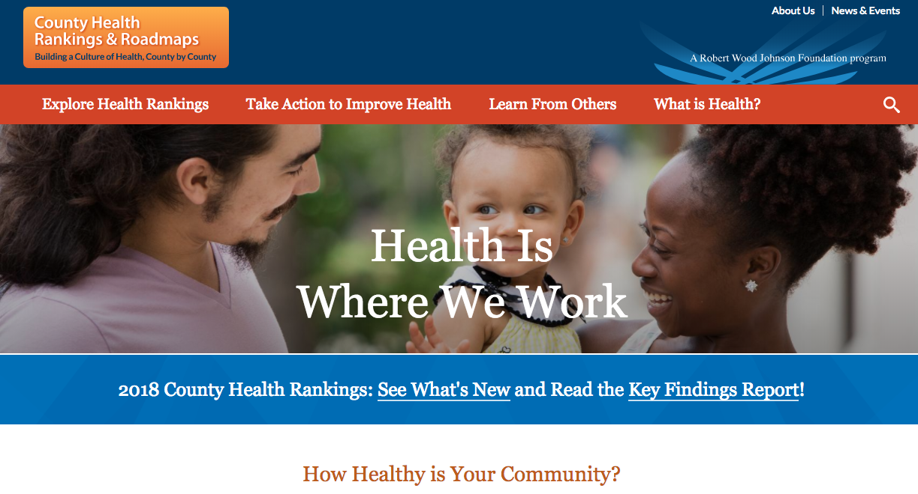
County Health Rankings
Notes:
Hopefully some of what you have heard today will help inform your next steps in terms of developing new initiatives, goals, and/or fundraising.
Both the data that is available from the Campaign on diversity in the workforce by state and the data from the county health rankings, can help highlight the workforce deficits, disparities within our states, and help us think about not only increasing numbers for diversity but also how to build and develop a diverse workforce to address community and public health needs.
We can all agree that when it comes to caring for communities, a nurses work is way beyond the bedside.

Slide 33

Campaign Resources

Slide 34
Culture of Health Measures as a Guide
Making Health a Shared Value
  Civic engagement
    Measure – Voter participation
Fostering Cross-sector Collaboration
  Quality of partnerships
    Measure – Local health department collaboration with community organization
Creating Healthier Communities
  Built environment and physical conditions
    Measure – Access to healthy foods
Strengthening Integration of Health Services & Systems
  Balance and integration
    Measure – Hospital partnerships
Notes:
The culture of health framework – more specifically the measures for each action area – can also be both a data point and a guide for how to connect a diverse workforce with community needs.
For example, in spaces where chronic diseases are the main causes of morbidity and mortality, are there opportunities to advocate for collaborating with local groups or non-profits to increase access to healthy foods and enhance the environment for walkability or physical activity. If voter participation is low, can nurses play a role in encouraging voter participation so that their needs and interests are considered in local policies.

Slide 35
Your Thoughts….
How do you feel about using these data sources to guide your work?
For those of you already familiar with these sources, how, if at all have you used them?
What type of support might you need to maximize some of the resources we have shared?
Notes:
Now we would like to hear from you, about how you feel about using some of the data sources that we have shared.
Does this information resonate with you?
Do you feel that it can be useful for helping you achieve your mission?
What are some of the challenges you anticipate with accessing and using this information?

Slide 36


Questions or Comments?
Press *1 on your telephone key pad to ask a question
(Please be sure to record your name after the prompt)
OR
Use the “chat” feature to send “everyone” a question.
If you are having trouble asking a question, please click the “Raise Hand” button on the bottom right of your screen
36
Notes:
WINIFRED
Thank the speakers and then ask the operator to Open the phone lines.
Winifred will facilitate the Q&A

